Slide 1



What is dependency injection and how is it implemented in Spring?
#1
Spring Boot Interview QnA
#SpringBootInterview #codefarm

Slide 2
What is Dependency Injection?
It is a design pattern used to implement Inversion of Control (IoC) in software applications
It allows a class's dependencies to be supplied by an external source rather than the class itself managing the creation and lifecycle of these dependencies
This leads to more modular, testable, and maintainable code.

Slide 3
Benefits
Decoupling
Testability
Maintainability
Flexibility

Slide 4
Types
Constructor Injection
Setter Injection
Field Injection

Slide 5
Dependency Injection in Spring
Implementing Dependency Injection in Spring
Constructor Injection
Setter Injection
Field Injection
Configuring Beans in Spring
Annotations
Java Config
XML Config

Slide 6

difference between @Component, @Repository, @Service, and @Controller annotations in Spring
#2
Spring Boot Interview QnA
#SpringBootInterview #codefarm

Slide 7
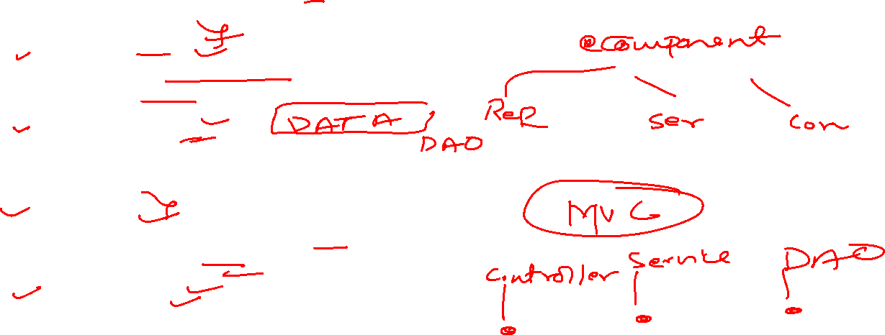
Explanation
@Component
Generic annotation for any Spring-managed component.
@Repository
Specialization for the persistence layer, with exception translation.
@Service
Specialization for the service layer, containing business logic.
@Controller
Specialization for the presentation layer, handling web requests.

Slide 8

How does Spring Boot simplify application development compared to Spring Framework?
#2
Spring Boot Interview QnA
#SpringBootInterview #codefarm

Slide 9
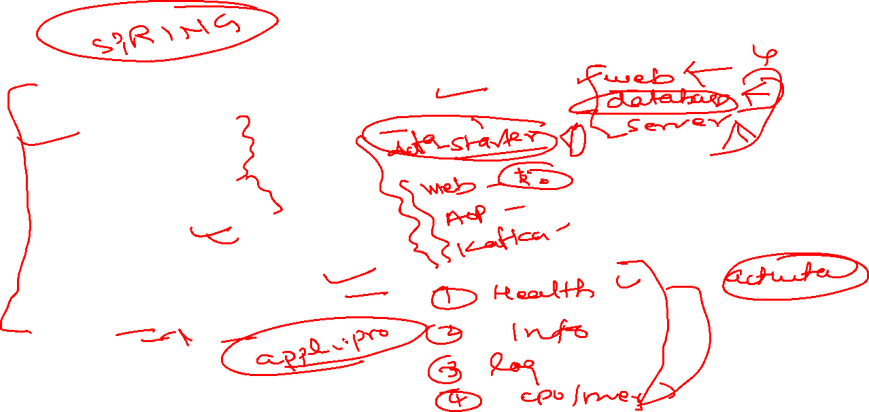
Explanation
Simplified Dependency Management
Auto configuration
Embedded server
Opinionated Defaults
Starter POMs
Production Ready Features
Externalized Config
Spring Initializr

Slide 10
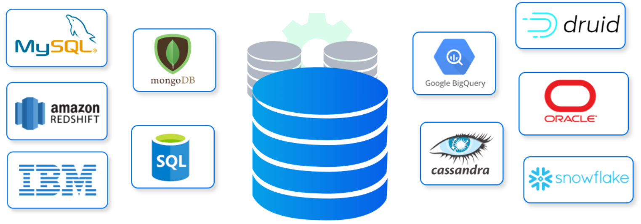


Explain the difference between SQL and NoSQL databases.
#1
Database Interview QnA
#DatabaseInterview #codefarm

Slide 11
Differences
Data Model
Schema
Scalability
Transaction Support
Query Language
Use Cases
Examples

Slide 12
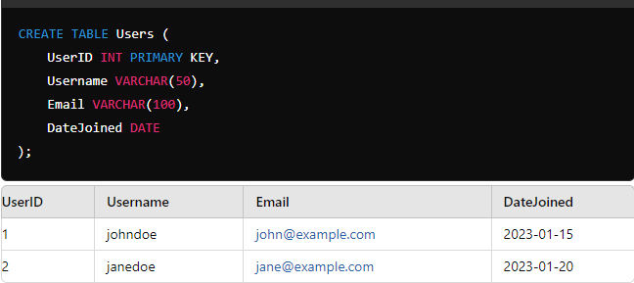
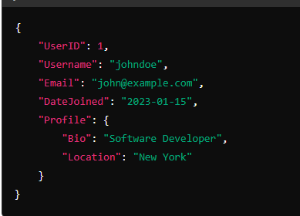
Data Model
SQL Databases
SQL (Structured Query Language) databases are relational.
They use a structured schema with tables, rows, and columns, where each table has a fixed schema defined by a set of fields.
The relationships between tables are established using foreign keys.
NoSQL Databases
NoSQL (Not Only SQL) databases are non-relational.
They can store unstructured, semi-structured, or structured data and often use flexible schemas.
Data can be stored in various formats, such as key-value pairs, documents, wide-columns, or graphs.

Slide 13
Schema
SQL Databases
They require a predefined schema before data can be inserted.
Any changes to the schema (e.g., adding a new column) can be complex and require careful planning.
NoSQL Databases
NoSQL databases typically have dynamic schemas, meaning fields can be added without affecting the existing data.
This allows for more flexibility and easier adaptation to changing data requirements.

Slide 14
Scalability
SQL Databases
SQL databases are generally vertically scalable, which means increasing the power of a single server (e.g., adding more RAM or CPU).
Horizontal scaling (adding more servers) can be challenging and complex.
NoSQL Databases
NoSQL databases are designed for horizontal scalability.
They can easily scale out by adding more servers to distribute the data and load, making them well-suited for handling large volumes of data and high-traffic applications.

Slide 15
Transaction Support
SQL Databases
SQL databases are known for their strong ACID (Atomicity, Consistency, Isolation, Durability) compliance, ensuring reliable transactions and data integrity.
NoSQL Databases
Many NoSQL databases sacrifice full ACID compliance for flexibility and performance.
They often follow the BASE model (Basically Available, Soft state, Eventually consistent), which is more suitable for distributed systems.

Slide 16
Query Language
SQL Databases
They use SQL as the standard query language, which is powerful for complex queries, joins, and aggregations.
NoSQL Databases
NoSQL databases often use query languages specific to their data model (e.g., MongoDB uses a JSON-like query language).
These are typically less standardized but can be more intuitive for specific data operations.

Slide 17
Use Cases
SQL Databases
Best suited for structured data and applications requiring complex queries, transactions, and data integrity.
Example - financial systems, traditional business applications.
NoSQL Databases
Ideal for unstructured or semi-structured data, large-scale applications, real-time analytics, and scenarios where flexibility, speed, and scalability are prioritized.
Example - social networks, IoT, big data applications.

Slide 18
Examples
SQL Databases
MySQL, PostgreSQL, Oracle, Microsoft SQL Server.
NoSQL Databases
MongoDB (document), Cassandra (wide-column), Redis (key-value), Neo4j (graph).

Slide 19
Summary
Feature | SQL Databases | NoSQL Databases
Data Model | Relational (Tables) | Non-relational (Document, Key-Value, Graph, etc.)
Schema | Fixed Schema | Dynamic Schema
Scalability | Vertical Scaling | Horizontal Scaling
Transaction Support | ACID Compliance | BASE Model (Eventual Consistency)
Query Language | SQL | Varied (e.g., JSON-based for MongoDB)
Data Integrity | High (Strong Consistency) | Varied (Eventual Consistency)
Use Cases | Structured Data, Complex Queries | Big Data, Real-time Analytics, Unstructured Data

